Slide 1


Android Application Development
Lecture 2(A): Beyond The Hello World
1. Project Structure Revisited
2. A Calculator Project
3. User Interface
4. Making the UI Active
5. Putting It All Together
Ahsanul Karim
karim.ahsanul@gmail.com
http://droidtraining.wordpress.com

Slide 2
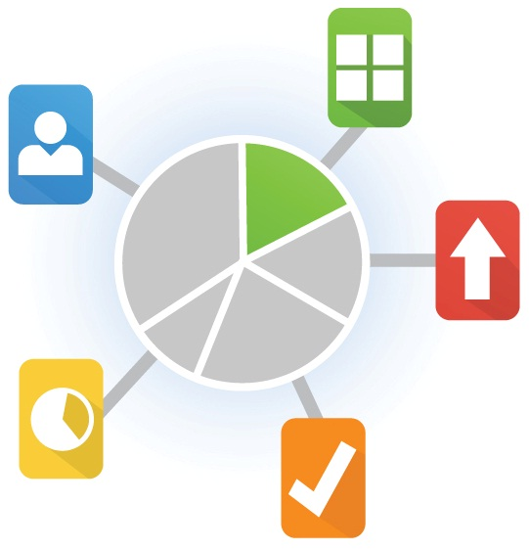
Beyond The Hello World
Today We'll Discuss...
1. Project Structure Revisited
2. A Calculator Project
3. User Interface
4. Making the UI Active
5. Putting It All Together
6. Assignment

Slide 3
Beyond The Hello World
Project Structure...
Project
-----src
----package
-----res
----drawable
----layout
----values
-----libs
-----assets
-----AndroidManifest.xml

Slide 4
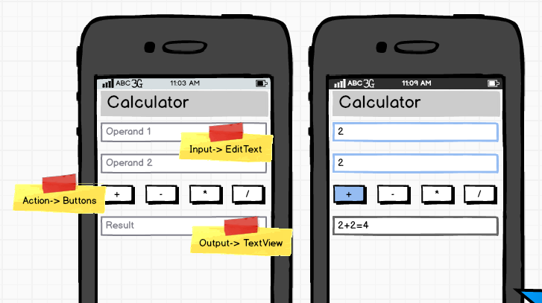
Beyond The Hello World
Calculator Project...
Project Name: Calculator
With Simple Arithmetic Operations

Slide 5
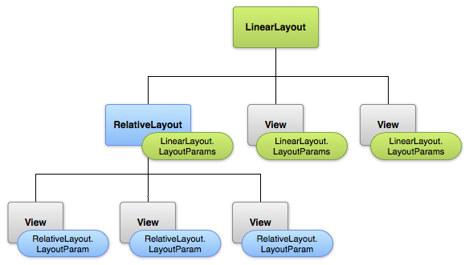
Beyond The Hello World
User Interface...

Slide 6
Beyond The Hello World
Calculator Project...
User Interface
Making the UI Active
Putting it All Together

Slide 7
Beyond The Hello World
Questions...
To raise new questions, new possibilities, to regard old problems from a new angle, requires creative imagination and marks real advance in science.
-Albert Einstein

